Slide 1



Application of Big Data Analytics via Soft Computing
Yunus Yetis

Slide 2


INTRODUCTION
System of Systems (SoS) and cyberphysic are integrated, independently operating systems working in a cooperative mode to achieve a higher performance.
SoSs are generating “Big Data” which makes modeling of such complex systems a challenge indeed
Big data is the term for data sets so large and complicated that it becomes difficult to process using traditional data management tools or processing applications.

Slide 3
What is BIG DATA?
Big data is the term for a collection of data sets so large and complex that it becomes difficult to process using on-hand database management tools or traditional data processing applications.
The challenges include capture, storage, search, sharing, transfer, analysis, and visualization.
The trend to larger data sets is due to the additional information derivable from analysis of a single large set of related data, as compared to separate smaller sets with the same total amount of data.

Slide 4
What is BIG DATA?
Air Bus A380
- 1 billion line of code
- each engine generate 10 TB every 30 min
640TB per Flight
Twitter Generate approximately 12 TB of data per day
New York Stock Exchange 1TB of data everyday
storage capacity has doubled roughly every three years since the 1980s

Slide 5
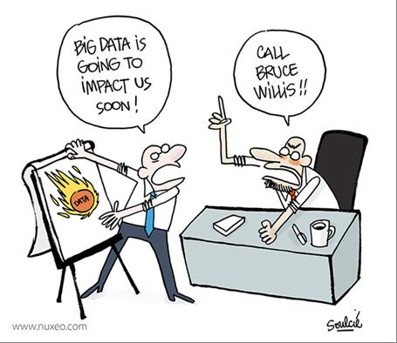
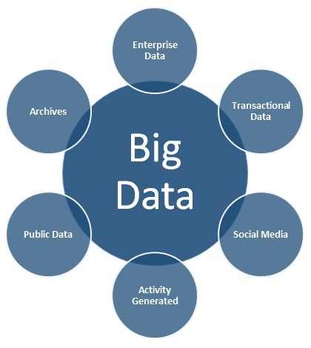
How big is the Big Data?
- What is big today maybe not big tomorrow
Any data that can challenge our current technology in some manner can consider as Big Data
Volume
Communication
Speed of Generating
Meaningful Analysis

Slide 6
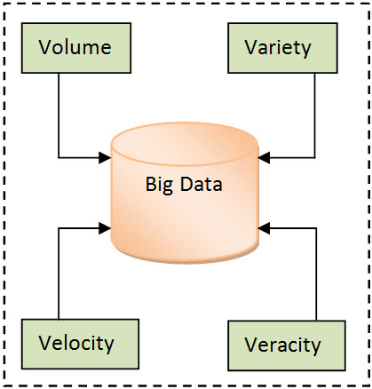
Big data can be described by the following characteristics
Volume
Variety
Velocity

Slide 7
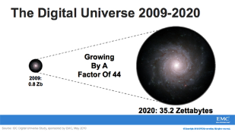
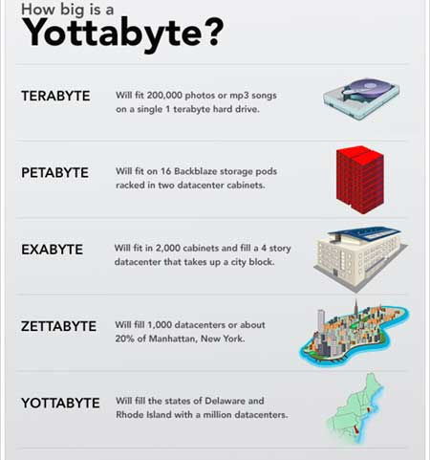
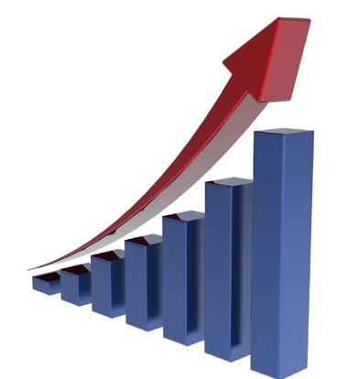
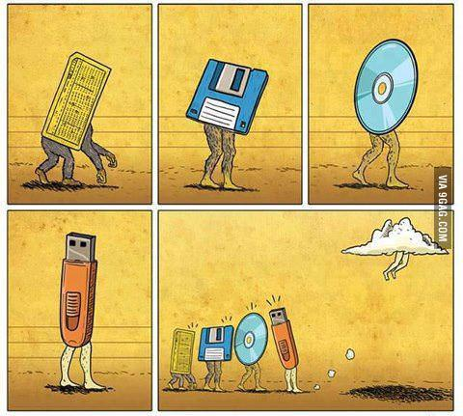
Volume (Scale)
Data Volume
44x increase from 2009 to 2020
From 0.8 zettabytes to 35zb
Data volume is increasing exponentially

Slide 8





4.6 billion camera phones world wide
30 billion RFID tags today (1.3B in 2005)
12+ TBs of tweet data every day
100s of millions of GPS enabled devices sold annually
? TBs of data every day
25+ TBs of log data every day
2+ billion people on the Web by end 2011
76 million smart meters in 2009… 200M by 2014

Slide 9
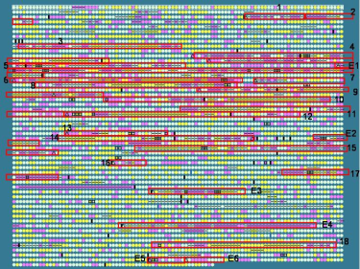
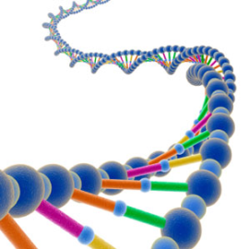
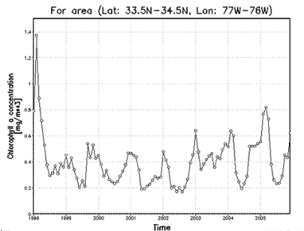
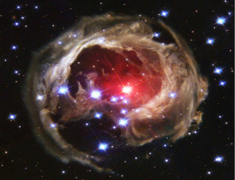
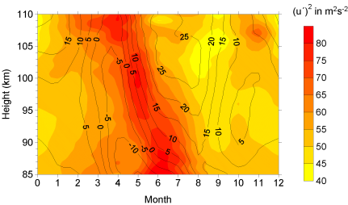

Variety (Complexity)
Relational Data (Tables/Transaction/Legacy Data)
Text Data (Web)
Semi-structured Data (XML)
Graph Data
Social Network,
Streaming Data
You can only scan the data once
A single application can be generating/collecting many types of data
Big Public Data (online, weather, finance, etc)

Slide 10

Velocity (Speed)
Data is generated fast and need to be processed fast
Examples
E-Promotions: Based on your current location, your purchase history, what you like ➔ send promotions right now for store next to you
Healthcare monitoring: sensors monitoring your activities and body ➔ any abnormal measurements require immediate reaction

Slide 11
Brief Description of Machine Learning
Principal Component Analysis (PCA)
Artificial Neural Networks (ANN)
Genetic Algorithm

Slide 12
Principal Component Analysis
Eigen Vectors show the direction of axes of a fitted ellipsoid
Eigen Values show the significance of the corresponding axis
The larger the Eigen value, the more separation between mapped data
For high dimensional data,
only few of Eigen values
are significant

Slide 13
Finding Eigen Values and Eigen Vectors
Deciding on which are significant
Forming a new coordinate system defined by the significant Eigen vectors
(→lower dimensions for new coordinates)
Mapping data to the new space
Compressed Data

Slide 14
Case study: Principal Component Analysis (PCA)
PCA is used abundantly in all forms of analysis because it is a simple, non-parametric method of extracting relevant information from confusing data sets.
PCA provides us a roadmap for how to reduce a complex data set to a lower dimension to save time and data storage.
It covers standard deviation, covariance, eigenvectors and eigenvalues.
First, it is the optimal (in terms of mse) linear scheme for compressing a set of high dimensional vectors into a set of lower dimensional vectors and then reconstructing
Second, the model parameters(covariance, eigenvectors and eigenvalues) can be computed directly from the data.
Another approaches to PCA is that it is not obvious how to deal properly with incomplete data set, in which some of the points are missing.

Slide 15
station | valid | (GMT | timezone | Air Temperature | Humidity in % | Wind Direction | Wind speed | Pressure altimeter | Sea Level Pressure | Sky level coverage | Sky level Altitide
IOW | 12/10/2012 | 13:52 | 21.02 | 77.45 | 300 | 16 | 29.93 | 1014.4 | 0 | 1400 | M
IOW | 12/10/2012 | 14:52 | 19.94 | 81.09 | 290 | 13.7 | 29.95 | 1015.3 | 0 | 1600 | M
IOW | 12/10/2012 | 15:52 | 19.94 | 77.35 | 300 | 12.5 | 29.96 | 1015.6 | 0 | 1600 | 3500
IOW | 12/10/2012 | 16:20 | 21.2 | 79.31 | 300 | 11.4 | 29.96 | M | 0 | 1600 | 3500
IOW | 12/10/2012 | 16:52 | 21.92 | 74.56 | 310 | 10.3 | 29.96 | 1015.5 | 0 | 3500 | M
IOW | 12/10/2012 | 17:13 | 23 | 73.51 | 300 | 11.4 | 29.95 | M | 0 | 1600 | 3700
IOW | 12/10/2012 | 17:52 | 24.08 | 70.81 | 310 | 11.4 | 29.94 | 1014.9 | 0 | 1600 | M
IOW | 12/10/2012 | 18:09 | 24.8 | 68.18 | 300 | 13.7 | 29.94 | M | 0 | 1600 | 4000
IOW | 12/10/2012 | 18:45 | 24.8 | 68.18 | 310 | 12.5 | 29.94 | M | 0 | 2900 | 4000
IOW | 12/10/2012 | 18:52 | 24.08 | 70.81 | 300 | 12.5 | 29.94 | 1014.6 | 0 | 2900 | 4000
IOW | 12/10/2012 | 19:52 | 24.98 | 71.47 | 310 | 12.5 | 29.93 | 1014.5 | 0 | 2900 | M
IOW | 12/10/2012 | 20:20 | 24.8 | 73.7 | 330 | 12.5 | 29.93 | M | 0 | 3100 | M
IOW | 12/10/2012 | 20:52 | 26.06 | 71.04 | 300 | 12.5 | 29.93 | 1014.4 | 0 | 1700 | 3100
IOW | 12/10/2012 | 21:02 | 26.6 | 73.89 | 320 | 11.4 | 29.93 | M | 0 | 1700 | M
IOW | 12/10/2012 | 21:52 | 26.06 | 74.41 | 320 | 12.5 | 29.95 | 1015 | 0 | 1700 | M
IOW | 12/10/2012 | 22:13 | 24.8 | 79.62 | 310 | 8 | 29.95 | M | 0 | 1700 | 4000
IOW | 12/10/2012 | 22:52 | 24.98 | 77.82 | 320 | 8 | 29.96 | 1015.4 | 0 | 4000 | M

Slide 16
Problem Statement
Create Neural Network to Wind Speed Prediction using large datasets which includes pattern of wind speed.
We have been encountered some issues;
The datasets sometimes may have missing values like wind datasets.
Analyzing of large datasets take much time.
Error and results are not stable because of that initial weights are randomly chosen, with typical values between -1.0 and 1.0 in Neural Network structure.

Slide 17
Solution and Implementation
Creating Neural network and PCA toolbox to get less error.
Output is Wind Speed
Inputs are;
Air temperature
Humidity
Wind direction
Pressure altimeter
Sea Level Pressure
Sky Level Coverage
Sky Level Altitude
Time Zone
http://mesonet.agron.iastate.edu/request/download.phtml?network=TR_ASOS

Slide 18
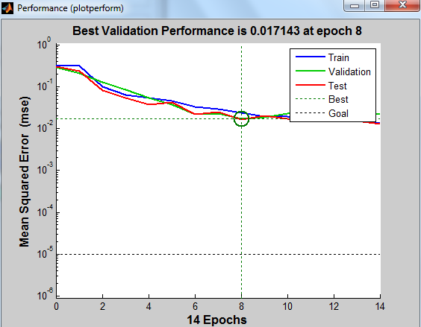
Check error before trying to correct
(Without PCA)
There is missing values and weights are randomly chosen, it looks worst results

Slide 19
PCA using ALS for Missing data
station | valid | (GMT | timezone | Air Temperature | Humidity in % | Wind Direction | Wind speed | Pressure altimeter | Sea Level Pressure | Sky level coverage | Sky level Altitide
IOW | 12/10/2012 | 13:52 | 21.02 | 77.45 | 300 | 16 | 29.93 | 1014.4 | 0 | 1400 | M
IOW | 12/10/2012 | 14:52 | 19.94 | 81.09 | 290 | 13.7 | 29.95 | 1015.3 | 0 | 1600 | M
IOW | 12/10/2012 | 15:52 | 19.94 | 77.35 | 300 | 12.5 | 29.96 | 1015.6 | 0 | 1600 | 3500
IOW | 12/10/2012 | 16:20 | 21.2 | 79.31 | 300 | 11.4 | 29.96 | M | 0 | 1600 | 3500
IOW | 12/10/2012 | 16:52 | 21.92 | 74.56 | 310 | 10.3 | 29.96 | 1015.5 | 0 | 3500 | M
When there are missing values in the data,find the principal components using the alternating least squares (ALS) algorithm.
Then reconstruct data matrix without Missing value

Slide 20
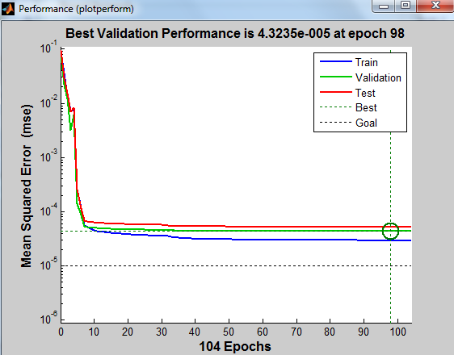
PCA using for Missing data

Slide 21
Results
It is necessary to get rid of missing value while we are forecasting with large datasets.
Preprocessing with PCA is very important to get less error(4.323e-005<< 0.01714).

Slide 22
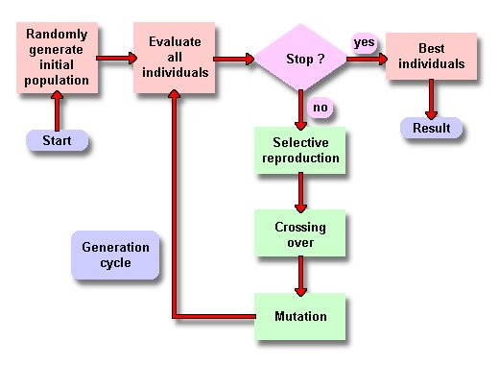
Genetic Algorithm
It is started with a set of randomly generated solutions and recombine pairs of them at random to produce offspring.
Only the best offspring and parents are kept to produce the next generation
Applications
Design of water distribution systems.
Distributed computer network topologies.
Electronic circuit design, known as Evolvable hardware.
File allocation for a distributed system
Mobile communications infrastructure optimization

Slide 23
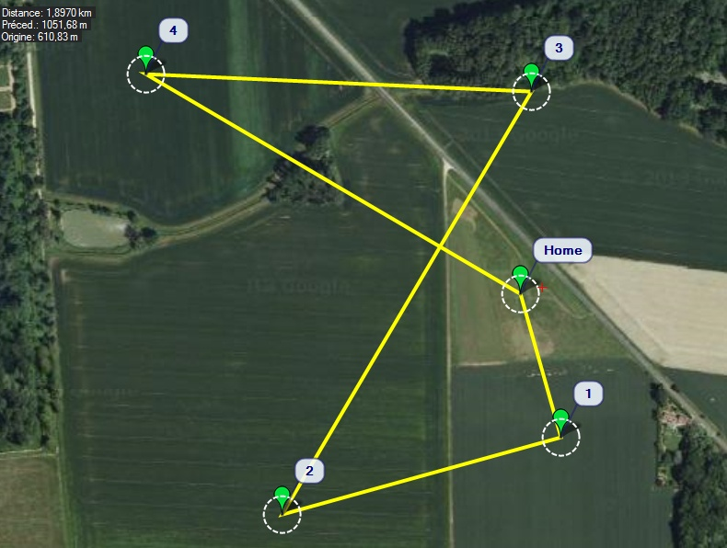

Genetic Algorithm
Ref: https://github.com/jlnaudin/x-drone/wiki/x-drone:-MaxiSwift,-mission-35---comparison-of-FPL-path-of-Real-flight-Vs-HIL-simulation

Slide 24
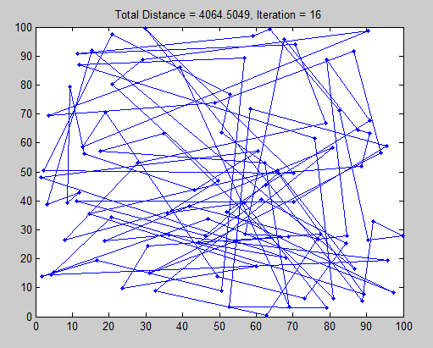
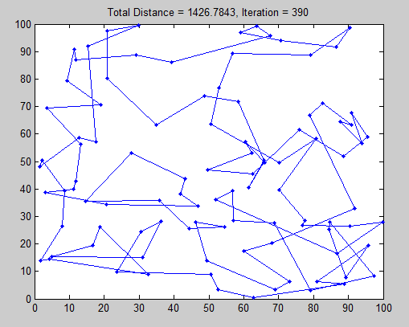
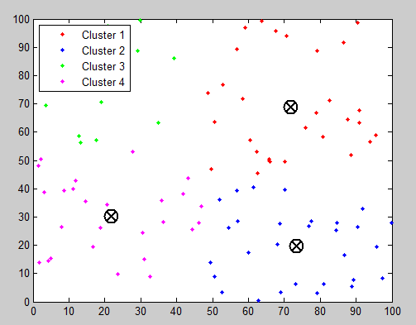
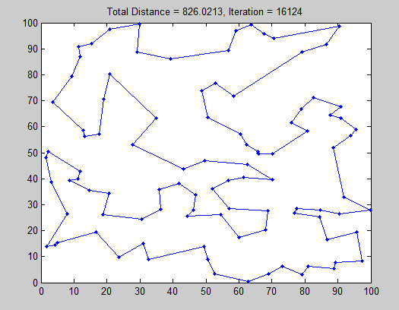
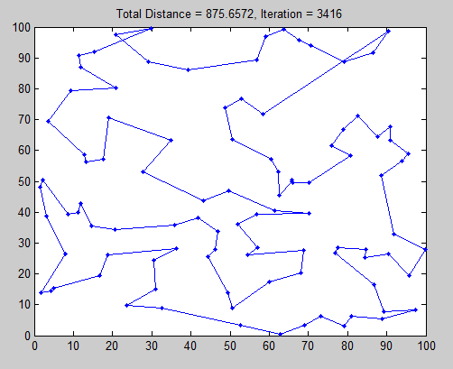

Slide 26
Artificial Neural Network
Inputs
Output
An artificial neural network is composed of many artificial neurons that are linked together according to a specific network architecture. The objective of the neural network is to transform the inputs into meaningful outputs.

Slide 27
Tasks to be solved by artificial neural networks:
controlling the movements of a robot based on self-perception and other information (e.g., visual information);
deciding the category of potential food items (e.g., edible or non-edible) in an artificial world;
recognizing a visual object (e.g., a familiar face);
predicting where a moving object goes, when a robot wants to catch it.
Neural network tasks
These can be reformulated in general as
FUNCTION APPROXIMATION
tasks.
control
classification
prediction
approximation
Approximation: given a set of values of a function g(x) build a neural network that approximates the g(x) values for any input x.

Slide 28
Artificial Neural Network
Problem Statement
To develop a graphical user interface which given the open price, high, low, volume of the day and the previous day’s closing price; outputs the estimated closing price of the day based on the previous data.
Collect amount of historical stock data
Using this data, train a neural network
Once trained, the neural network can be used to predict stock behavior
Need to some way to gauge value of results – we will compare with www.finance.yahoo.com as well as compare with what actually happened

Slide 29
Advantages & Disadvantages
Advantages
>> Neural network can be trained with a very large amount of data. Years, decades, even centuries
>> Able to consider a “lifetime” worth of data when making a prediction
>> Completely unbiased
Disadvantages
>> No way to predict unexpected factors, i.e. natural disaster, legal problems, etc.

Slide 30
Neural networks are used to predict stock market prices because they are able to learn nonlinear mappings between inputs and outputs.
Several researchers claim the stock market and other complex systems exhibit chaos.
With the neural networks’ ability to learn nonlinear, chaotic systems, it may be possible to outperform traditional analysis and other computer-based methods.

Slide 31
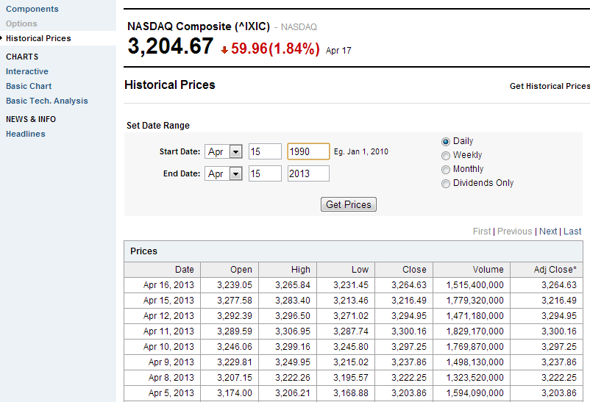
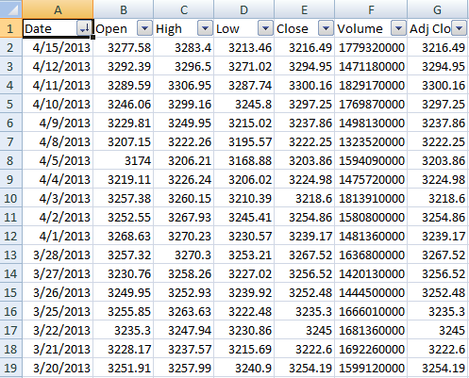
Download the Spreadsheet from http://finance.yahoo.com/q/hp?s=%5EIXIC+Historical+Prices

Slide 32
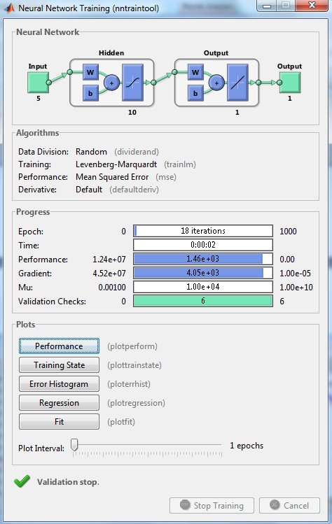
Backpropagation is the process of backpropagating errors through the system from the output layer towards the input layer during training.
Backpropagation is necessary because hidden units have no training target value that can be used, so they must be trained based on errors from previous layers.
The output layer is the only layer which has a target value for which to compare.

Slide 33
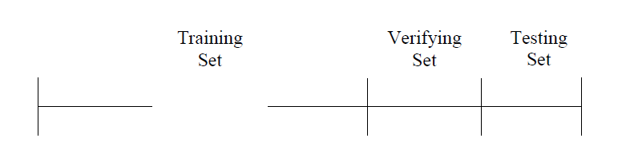
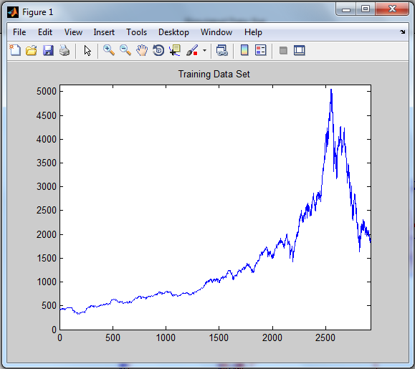
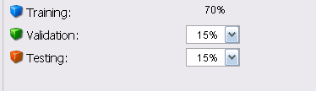
With these settings, the input vectors and target vectors will be randomly divided into three sets as follows:
70% will be used for training.
15% will be used to validate that the network is generalizing and to stop training before overfitting.
The last 15% will be used as a completely independent test of network generalization.

Slide 34
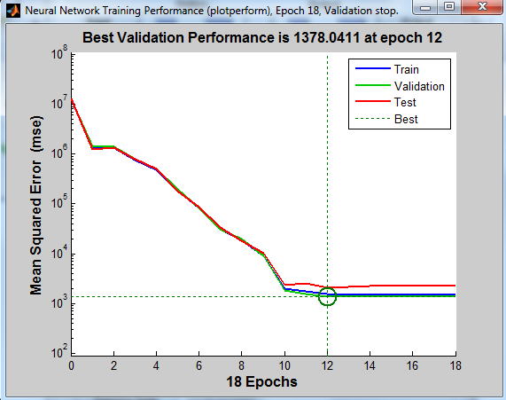
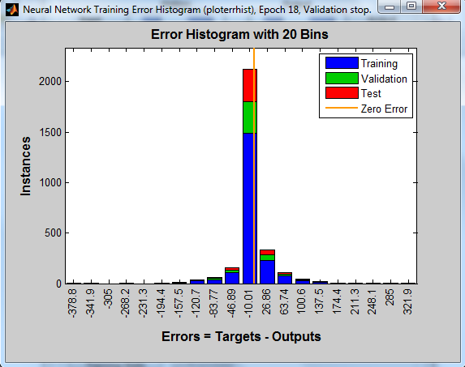
The result is reasonable because of the following considerations:
The train set error , the validation set error and test set error have similar characteristics.
Error histogram to obtain additional verification of network performance.
You can see that while most errors fall between -120 and 100.

Slide 35
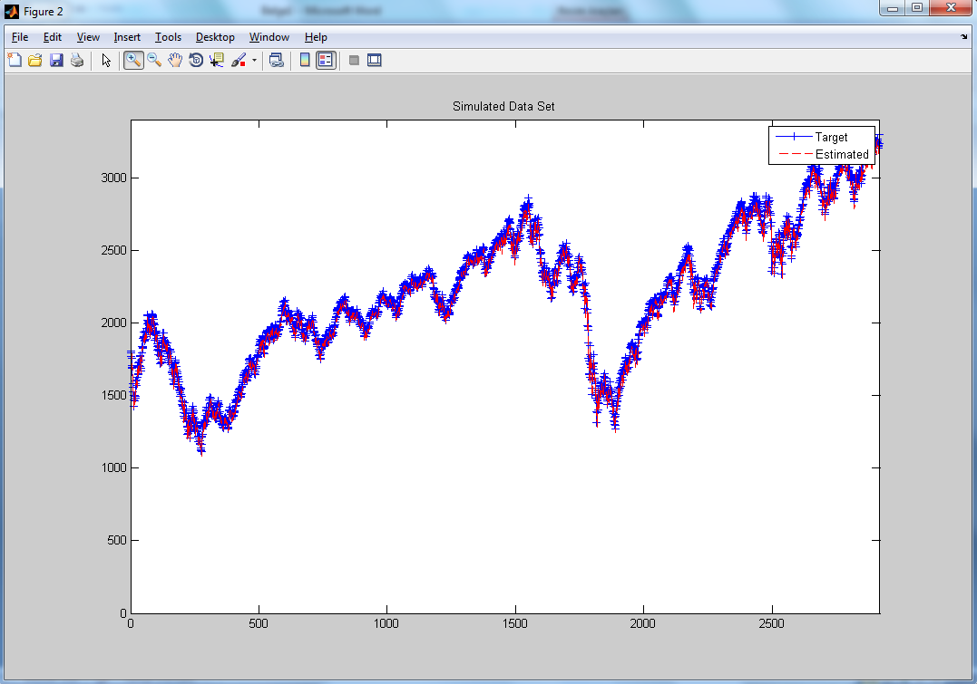
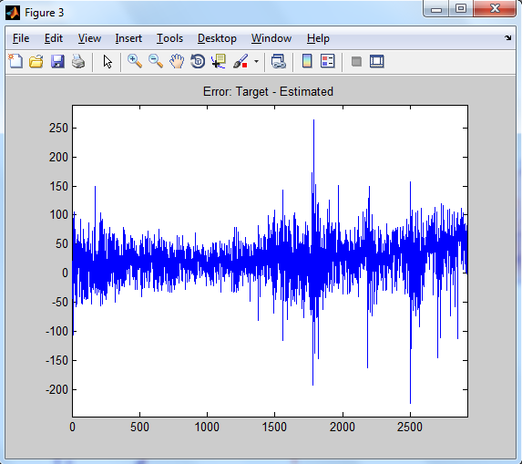

Slide 36
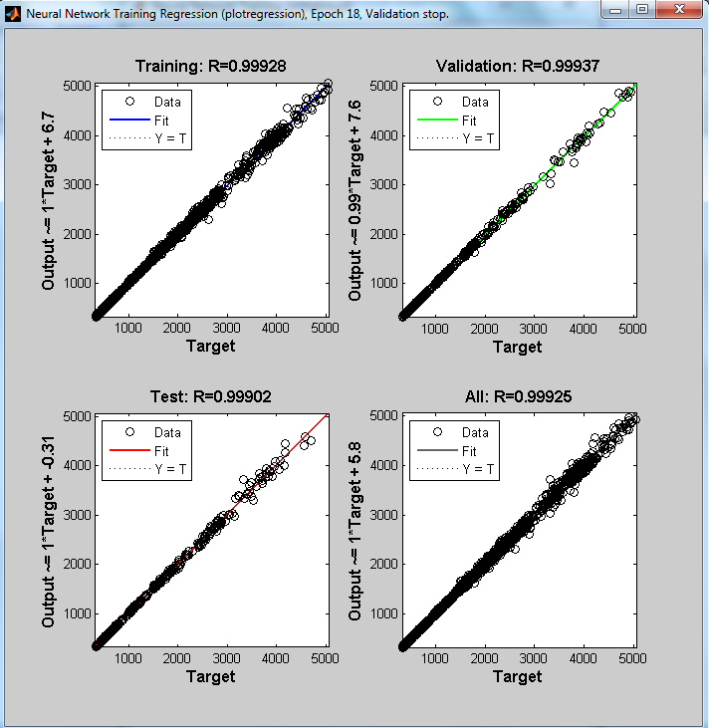
Regression is used to validate the network performance.
The following regression plots display the network outputs with respect to targets for training, validation, and test sets.
For a perfect fit, the data should fall along a 45 degree line, where the network outputs are equal to the targets.
For this problem, the fit is reasonably good for all data sets, with R values in each case of 0.99 or above.

Slide 37
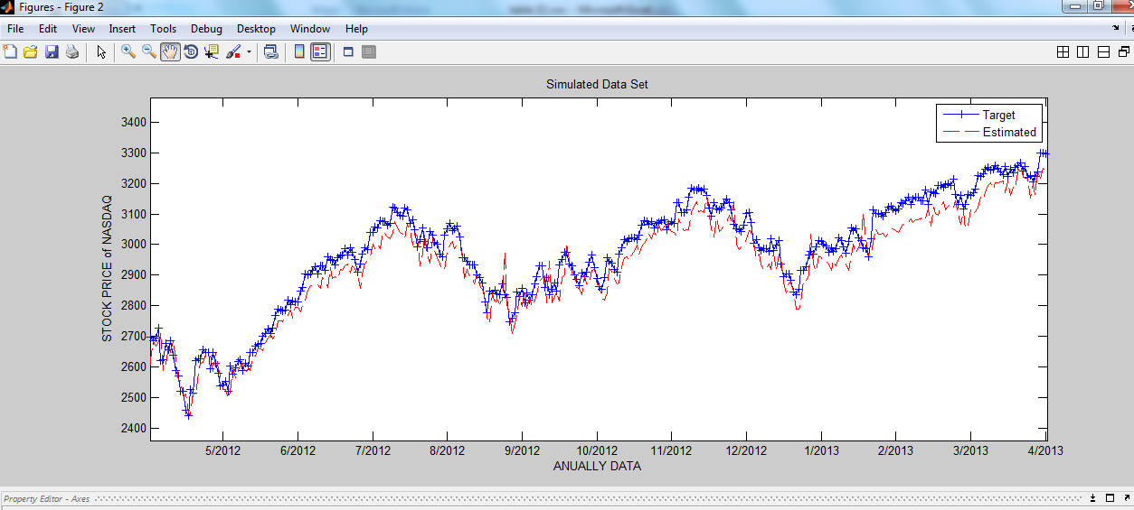
VISUALIZATIONS

Slide 38
Conclusion
Our model shows promise, but needs improvement before becoming an effective aid.
Needs more data, possibly more types of data
No human or computer can perfectly predict the volatile stock market
Under “normal” conditions, in most cases, a good neural network will outperform most other current stock market predictors and be a very worthwhile, and potentially profitable aid to investors

Slide 39
References
[1] M. Jamshidi (ed.), Systems of Systems Engineering—Principles and Applications (CRC/Taylor & Francis, London, 2008) (also in Mandarin language, China Machine Press, ISBN 978-7- 111-38955-2, Beijing, 2013)
[2] M. Jamshidi (ed.), System of Systems Engineering—Innovations for the 21st Century (Wiley, NewYork, 2009)
[3] Jamshidi, Mo, Barney Tannahill, Yunus Yetis, and Halid Kaplan. "Big Data Analytic via Soft Computing Paradigms." In Frontiers of Higher Order Fuzzy Sets, pp. 229-258. Springer New York, 2015.
[4] Yetis, Y., Kaplan, H., & Jamshidi, M. (2014). Stock market prediction by using artificial neural network. In World Automation Congress Proceedings. (pp. 718-722).

Slide 40


THANK YOU FOR TIME

